Slide 1
CIS 449/549: Software Security
Anys Bacha
Slides from U. Shankar, M. Hicks, K. Du, D. Boneh, N. Zeldovich, A. Rahmati

Slide 2
Principles for Secure Design

Slide 3
Making Secure Software
Flawed approach: Design and build software, ignore security at first
Add security once the functional requirements are satisfied
Better approach: Build security in from the start
Incorporate security-minded thinking into all phases of the development process

Slide 4
Development process
Phases
Security Engineering (Pertains to all phases)
Security Requirements
Requirements
Abuse Cases
Design
Architectural Risk Analysis
Security-oriented Design
Implementation
Code Review (with tools)
Testing/assurance
Risk-based Security Tests
Penetration Testing
Note that different processes have different phases and artifacts, but all
involve the basics above. We’ll keep it simple and refer to these

Slide 5
Software vs Hardware
System design contains software and hardware
Mostly, we are focusing on the software
Software is malleable and easily changed
Advantageous to core functionality
Harmful to security (and performance)
Hardware is fast, but hard to change
Disadvantageous to evolution
Advantage to security
Can’t be exploited easily, or changed by an attack
Notes:
Chicken switch: used by intel, can change ROM bit to change security functionality.
Example of hardware design flaw: Spectre attack.

Slide 6
Secure Hardware
Security functionality in hardware
Intel’s AES-NI implements cryptography instructions
Intel SGX: per-process encrypted enclave
Protect application data from the OS
Hardware primitives for security
Physically uncloneable functions (PUFs)
Source of unpredictable, but repeatable, randomness, useful for authentication (encrypt/decrypt based on what you own, not through password) – called doping.
Intel MPX - primitives for fast memory safety
Notes:
AES-NI can accelerate encryption through the hardware (hardware acceleration).
SGX = Software Guard Encryption
Doping: source of variation comes because no chip’s transistors will have the exact same number of atoms.
So we take advantage of this uniqueness.
The manufacturing process that causes this, is why chip manufactures will bend (stress test) each chip and based on their atomic setup, some chips run at higher frequency than others.
This is why overclocking can be a good idea, but also you need to be careful if you over stress the processor chip.

Slide 7
Requirements
Security Requirements
Abuse Cases
Threat Modeling
Notes:
Security of a system depends on the threat model you assume
Once attacker steps outside of that model: game over.

Slide 8
Threat Model
The threat model makes explicit the adversary’s assumed powers
Must match reality, otherwise risk analysis of the system will be wrong
The threat model is critically important: without the threat model
Cannot assess whether your design will repel that attacker
Saying “This system is secure” means nothing

Slide 9
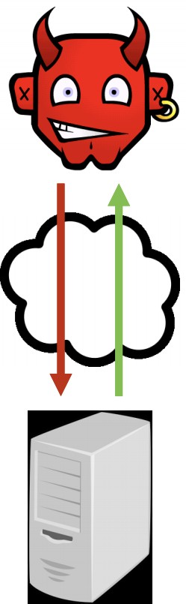
Example network threat model: Malicious user
Is a user who can connect to a service via the network
May be anonymous
Can:
Measure the size and timing of requests and responses
Run parallel sessions
Provide malformed inputs or messages
Drop or send extra messages
Design: No need to encrypt communications (what about telnet?)
Example attacks a malicious user can perform
SQL injection, XSS, CSRF, buffer overrun
Notes:
telnet= plaintext (unencrypted) communication.

Slide 10
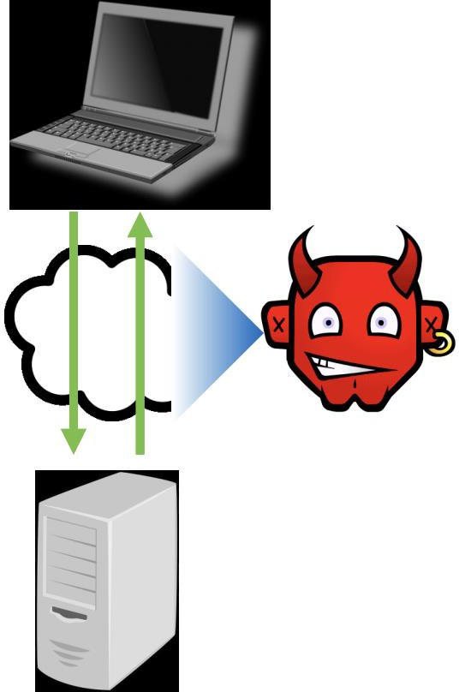
Example network threat model: Snooping User
Attacker on same network as other users
e.g., Unencrypted Wi-Fi at coffee shop
Can read/measure others’ messages
May also intercept, duplicate, and modify
Design: Use encrypted communications
application (TLS), network (IPsec), link (wifi)
Example attacks a snooping user can conduct:
Session hijacking (read session key of a user and re-use it), side-channel attack (violate privacy by reading unencrypted data), DoS
Notes:
Snooping= listening.

Slide 11
Example network threat model: Co-located user
Attacker on same machine as other users
E.g., malware installed on a user’s laptop
Thus, can additionally
Read/write user’s files (e.g., cookies) and
memory
Snoop keypresses and other events
•
Design:
Encrypt all stored (sensitive) information
Sandbox applications to isolate keylogger
Example attacks: Password theft (and other credentials/secrets) through keylogging

Slide 12
Bad Model = Bad Security
The assumptions you make are potential holes the attacker can exploit
E.g.: Assuming there are no snooping users is no longer valid
wi-fi networks are widespread in most deployments
Other mistaken assumptions
Assumption: Encrypted traffic carries no information
Not true! By analyzing the size and distribution of messages, you can infer application state
Assumption: Timing channels carry little information
Not true! Timing measurements of previous RSA implementations could eventually reveal a TLS secret key
Notes:
Remember: wifi NICs are just sensors!
Example of timing channels: measure timing on how long it takes to access data, can allow a person to know if data is coming from cache or memory, and based on that you can reconstruct the key easier.

Slide 13
Finding a good model
One way to find a good model is to compare against similar systems
What attacks does their design contend with?
Understand past attacks
How do they apply to your system?
Notes:
Think about it: attackers do not want/have time to start from scratch either, so they consider the above points from their own point of view.

Slide 14
Finding a good model
It is important to challenge assumptions in your design
Don’t settle for the status quo and ask yourself these questions:
What happens if an assumption is false?
What would a breach potentially cost you?
How hard would it be to get rid of an assumption in order to model a stronger adversary?
At the same time, be realistic
What would the development cost be?
Notes:
Safety does not necessarily mean security.

Slide 15
Requirements
Security Requirements
Abuse Cases
Security Requirements, Abuse Cases

Slide 16
Security Requirements
Software requirements are typically about what software should do
But we also want security requirements
This is in the form of: Security-related goals or policies
Example: One user’s bank account balance should not be
learned by, or modified by, another user (unless authorized)

Slide 17
Security Requirements
Mechanisms for enforcing policies:
Example:
Users identify themselves using passwords
passwords are “strong”
password databases are only accessible to a login program.

Slide 18
Typical Kinds of Requirements
Policies (CIA)
Confidentiality (and Privacy and Anonymity)
Integrity
Availability
Supporting mechanisms include (AAA):
Authentication (proper identification of users/resources in order to enforce the other 2)
Authorization (access control)
Auditability

Slide 19
Policy: Confidentiality
Confidentiality implies that sensitive information is not leaked to unauthorized users
An example policy:
A bank account status (including balance) is known only to the account owner
Privacy implies to provide confidentiality for individuals
Anonymity is a special kind of privacy
Example: Non-account holders should be able to browse the bank site without being tracked (Here the adversary is the bank)
Where do Google and Facebook stand on this?

Slide 20
Policy: Confidentiality
Example violations could be done directly or indirectly via side channels
For example:
Manipulating the system to directly display Bob’s bank
balance to Alice
Or determining Bob has an account at Bank A according to a shorter delay on login failure (don’t exhaust the entire database before returning)
Notes:
TIMING CAN REVEAL DATA (THROUGH IMPLICATION/INFERENCE)

Slide 21
Policy: Integrity
Definition: Sensitive information is not changed by unauthorized parties or computations
Example: Only the account owner can authorize withdrawals from her account
Violations of integrity can also be direct or indirect
Example: Withdrawing from an account yourself vs. confusing the system into doing it (think CSRF attack)
Notes:
CSRF=cross site request forgery attack

Slide 22
Policy: Availability
Definition: A system is responsive to requests
Example: A user may want to always access her account for balance queries or withdrawals
Denial of Service (DoS) attacks attempt to compromise availability
By busying a system with useless work
Or cutting off network access
Notes:
Goes into the RAS domain=Reliability, availability, serviceability.
Google the Slow Laurus DoS attack: attack exhausted number of connections allowed on a web server.

Slide 23
How to support a mechanism: Authentication
Who/what is the subject of security policies?
We need a notion of identity and a way to connect the action
with an identity
This is also known as a principal

Slide 24
How to support a mechanism: Authentication
How can a system tell a user is who she says she is?
What: (only) she knows (e.g., password)
What: she is who she is (e.g., biometric)
What she has (e.g., smartphone, RSA token)
Authentication mechanisms that employ more than one of these factors are called multi-factor authentication
E.g., passwords and text a special code to user’s smart phone

Slide 25
Supporting mechanism: Authorization
It is also important to define when a principal may perform an action
Example: Bob is authorized to access his own account, but not
Alice’s account
Access-control policies define what actions might be authorized
May be role-based, user-based, etc.

Slide 26
Supporting mechanism: Auditability
Retain enough information to determine the circumstances of a breach or misbehavior
Often stored in log files
Must be protected from tampering (blockchain?),
Disallow access that might violate other policies
Example: Every account-related action is logged locally and mirrored at a separate site
Only authorized bank employees can view log

Slide 27
Defining Security Requirements
There are many processes for deciding security requirements
Example: General policy concerns
Due to regulations/standards (HIPAA, etc.)

Slide 28
Defining Security Requirements
Example: Policy arising from threat modeling
Which attacks cause the greatest concern?
Who are likely attackers, what are their goals and methods?
Which attacks have already occurred?
Within the organization, or elsewhere on related systems?
Notes:
Try to understand the psychology of the attacker.

Slide 29
Abuse Cases
Must be in line with the security requirements
Must describe what a system should not do
Example use case: A system allows bank managers to modify an
account’s interest rate
Example abuse case: A user can spoof being a manager and modify account interest rates
Notes:
Spoof=impersonation

Slide 30
Defining Abuse Cases
Use attack patterns and likely scenarios to consider how an
attacker’s power could violate a security requirement
Based on the threat model you put together
What might occur if a security measure was removed?
This allows you to build some fault tolerance in your system and strengthen your mechanisms you put in place

Slide 31
Examples of Defining Abuse Cases
Example: A co-located attacker steals a password file and learns all user passwords
This is possible if password file is not properly hashed, salted
Example: Snooping where an attacker replays a captured message, effecting a bank withdrawal (replay attack)
Possible if messages have no nonce
Nonce=number used once (initialization vector) when establishing communication; used to prevent replay attacks.
Notes:
Salt value = random bit pattern appended to password to make password harder to brute force.
Remember hash function = 1 way function (for the most part; it should have little to nearly impossible probability of collisions to be considered cryptographically strong)

Slide 32
Design
Security-oriented design
Security design principles

Slide 33
Design Defects = Flaws
Recall: Software defects = both flaws and bugs
Here we classify
Flaws as problems in the design
Bugs are problems in the implementation
We avoid flaws during the design phase
According to Gary McGraw, 50% of security problems are flaws
So this phase is very important

Slide 34
Categories of Principles
Prevention: Eliminate software defects entirely
Example: Heartbleed bug (buffer overflow) would have been prevented by using a type-safe language, like Java
Mitigation: Reduce harm from exploitation of unknown defects
Example: Run each browser tab in a separate process, so exploiting one tab does not give access to data in another
Detection/Recovery: Identify, understand an attack; undo damage
Examples: Monitoring, snapshotting

Slide 35
Principles for building secure systems
The general rule of thumb is that when principles are neglected they result in design flaws
Security is economics
Principle of least privilege
Use fail-safe defaults
Use separation of responsibility
Defend in depth
Account for human factors
Ensure complete mediation
Kerkhoff’s principle
Accept that threat models change over time
If you can’t prevent, detect
Design security from the ground up
Prefer conservative designs
Proactively study attacks
Notes:
Security is bound by time to market.
Give modules least amount of permissions possible.
Sometimes developers want to avoid instability issues so they just ask for all permissions
However, this can cause security issues.
Fail-safe defaults: make app crash instead of attempting to correct a mistake → terminate the process is safer.
Defend in depth: False negatives and false positives can create vulnerability, check for these cases.
Human factors: check willingness and ability of user to the extent which the security depends.
Kerkhoff’s principle: assume the attacker has access to defense models/modules.
Whitebox testing.

Slide 36
“Security is economics”
You can’t afford to secure against everything, so what do you defend
against?
Answer: That which has the greatest “return on investment”
THERE ARE NO SECURE SYSTEMS, ONLY DEGREES OF INSECURITY
In practice, need to resist a certain level of attack
Example: Safes come with security level ratings
“Safe against safecracking tools & 30 min time limit”
Corollary: Focus energy & time on weakest link
Corollary: Attackers follow the path of least resistance

Slide 37
“Principle of least privilege”
Give a program the access it legitimately needs to do its job. NOTHING MORE
Example: Unix does a BAD JOB:
Every program gets all the privileges of the user who invoked it
vim as root: it can do anything -- should just get access to file
Example: Windows JUST AS BAD, MAYBE WORSE
Many users run as Administrator,
Many tools require running as Administrator

Slide 38
“Principle of least privilege”
Give a program the access it legitimately needs to do its job. NOTHING MORE
Example: Smartphones:
Apps tend to require unnecessary resources and sensors in order to be installed

Slide 39
“Use fail-safe defaults”
Things are going to break. So break safely.
Default-deny policies
Start by denying all access
Then allow only that which has been explicitly permitted
Crash => fail to a secure behavior
Example: firewalls are explicitly setup to forward (whitelist method)
Failure => packets don’t get through (block everything including white list)
Notes:
White list v black list:
Black list = allow all by default, block anything on black list
White list = deny all by default, allow anything on white list
Default-deny = use white list approach.

Slide 40
“Use separation of responsibility”
Split up privilege so no one person or program has total power.
Example: US government
Checks and balances among different branches
Example: Movie theater
One employee sells tickets, and another person tears the tickets
Example: Nuclear weapons… (multiple parties required to allow a launch)

Slide 41
“Defend in depth”
Use multiple, redundant protections
Only in the event that all of them have been breached should security be endangered.
Example: Multi-factor authentication:
Some combination of password, image selection, USB dongle,
fingerprint, iris scanner,…
Example: “You can recognize a security guru who is particularly
cautious if you see someone wearing both...
…a belt and suspenders

Slide 42
“Ensure complete mediation”
Make sure your reference monitor sees every access to every object
Any access control system has a resource that it needs to enforce
For example: Who is allowed to access a file (specific group, user, etc.)
Another example: Who is allowed to post to a message board/topic…
Reference Monitor: The piece of code that checks for permission to access a resource

Slide 43
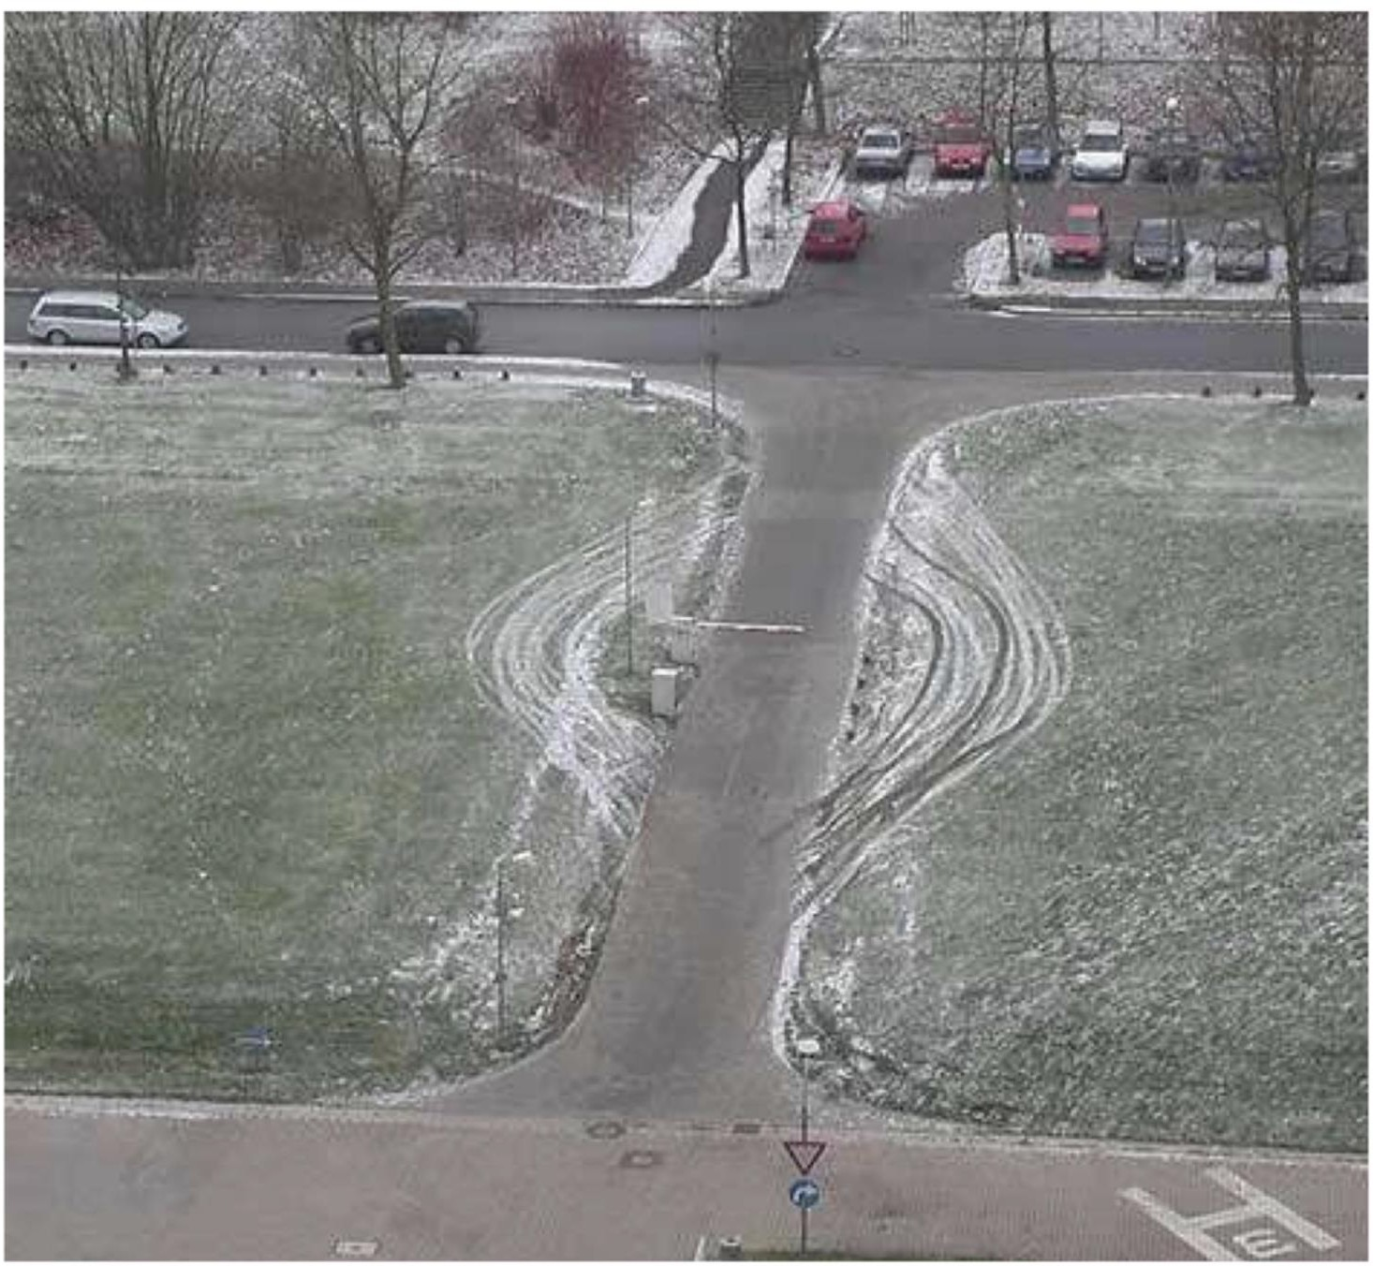
Ensure complete mediation!

Slide 44
“Account for human factors”
(1) “Psychological acceptability”:
In other words, users must buy into the security model
The security of your system ultimately lies in the hands of those who use it: its important that users are onboard.
If they don’t believe in the system or the cost it takes to secure it, then they won’t do it.
Example: “All passwords must have 15 characters, 3 numbers, 6 special characters, …”
Notes:
Example: “All passwords must have 15 characters, 3 numbers, 6 special characters, …”
Something interesting about this: if you make this a requirement, although the domain increases, some of the domain is deleted since any password without those requirements are not allowed, so attacker will not have to check those passwords.
So is the total domain really increased?

Slide 45
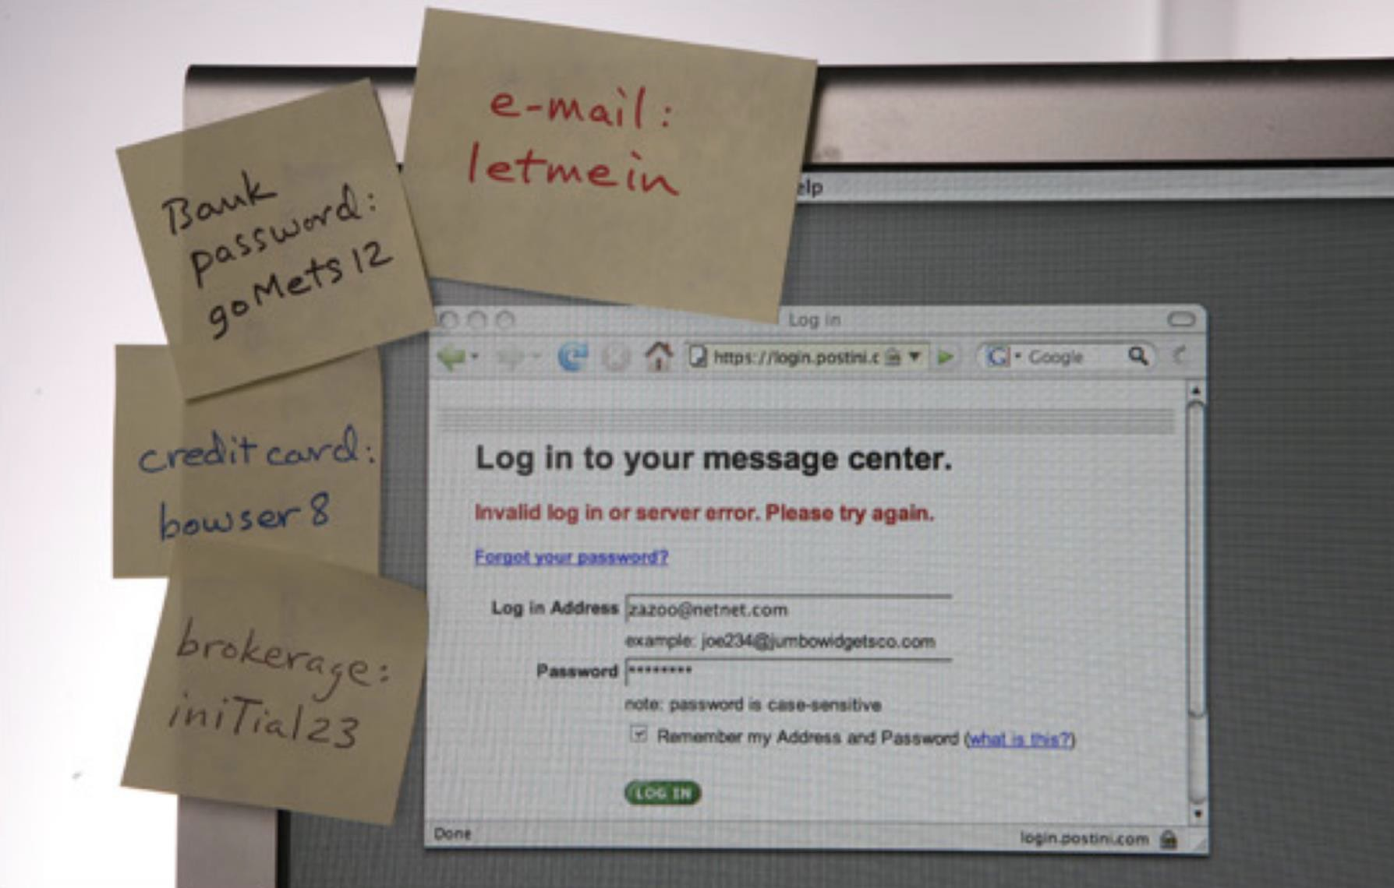
(1) Users must buy into the security

Slide 46
“Account for human factors”
(2) The security system must be usable
The security of your system ultimately lies in the hands of those who use it.
If it is too hard to act in a secure fashion, then they won’t do it.
Example: Popup dialogs

Slide 47
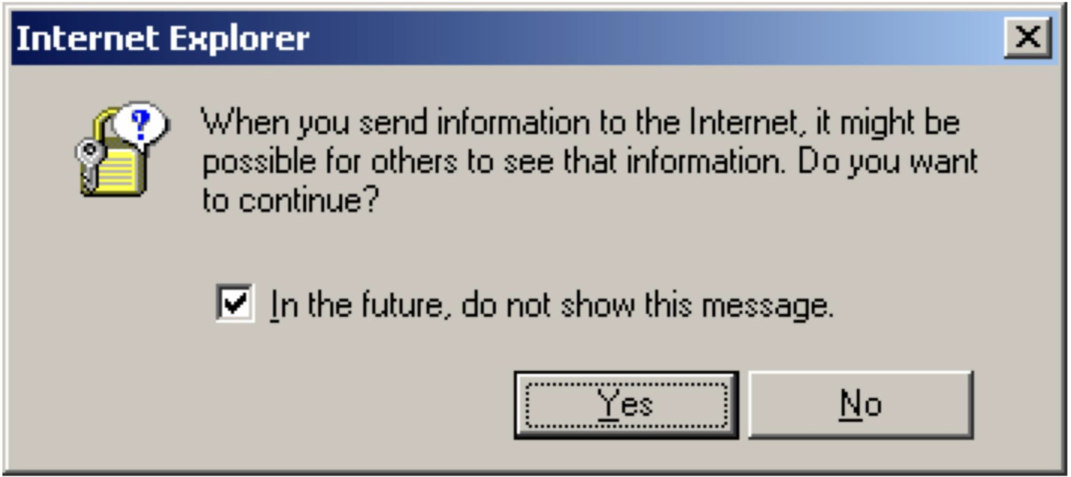
“Account for human factors”
User needs to be onboard

Slide 48
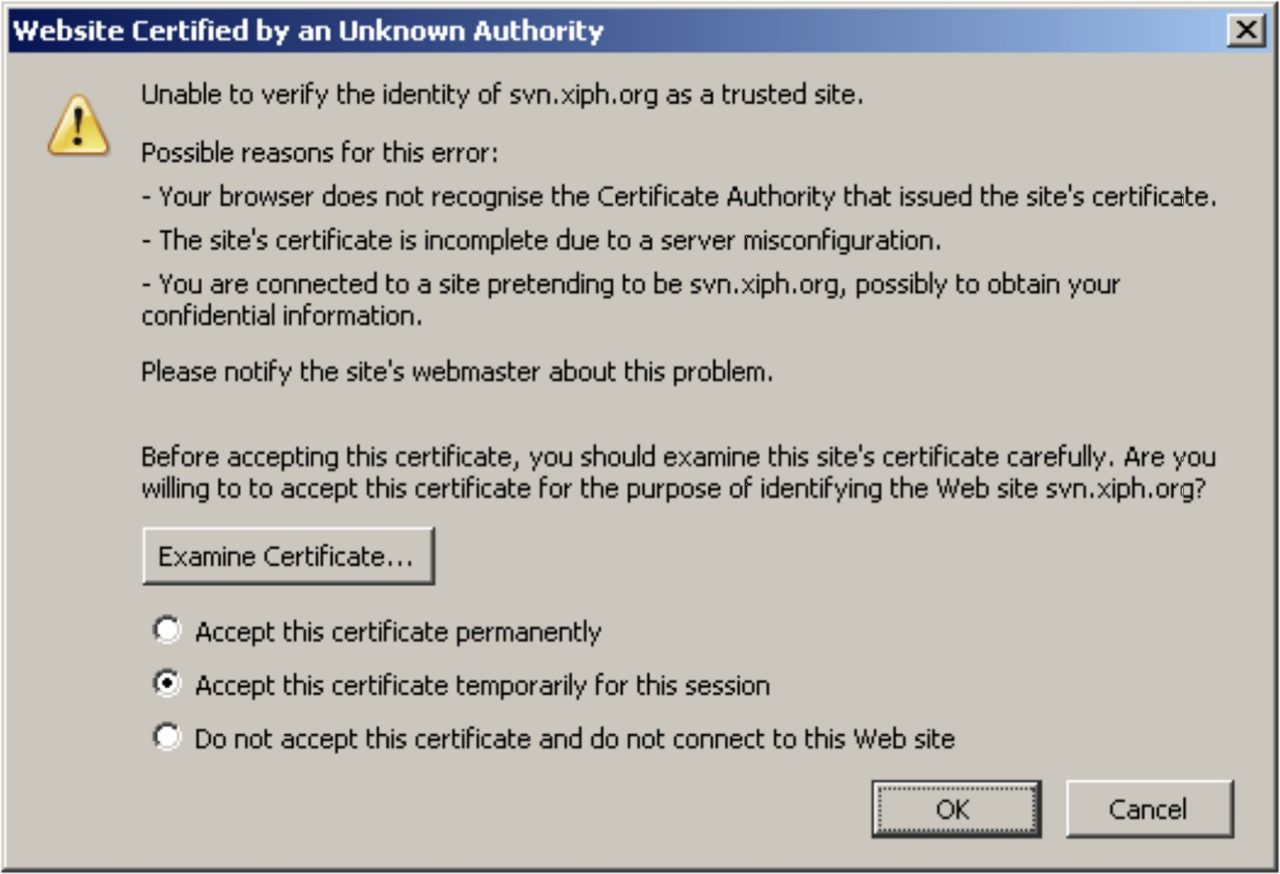
“Account for human factors”
User needs to be onboard

Slide 49
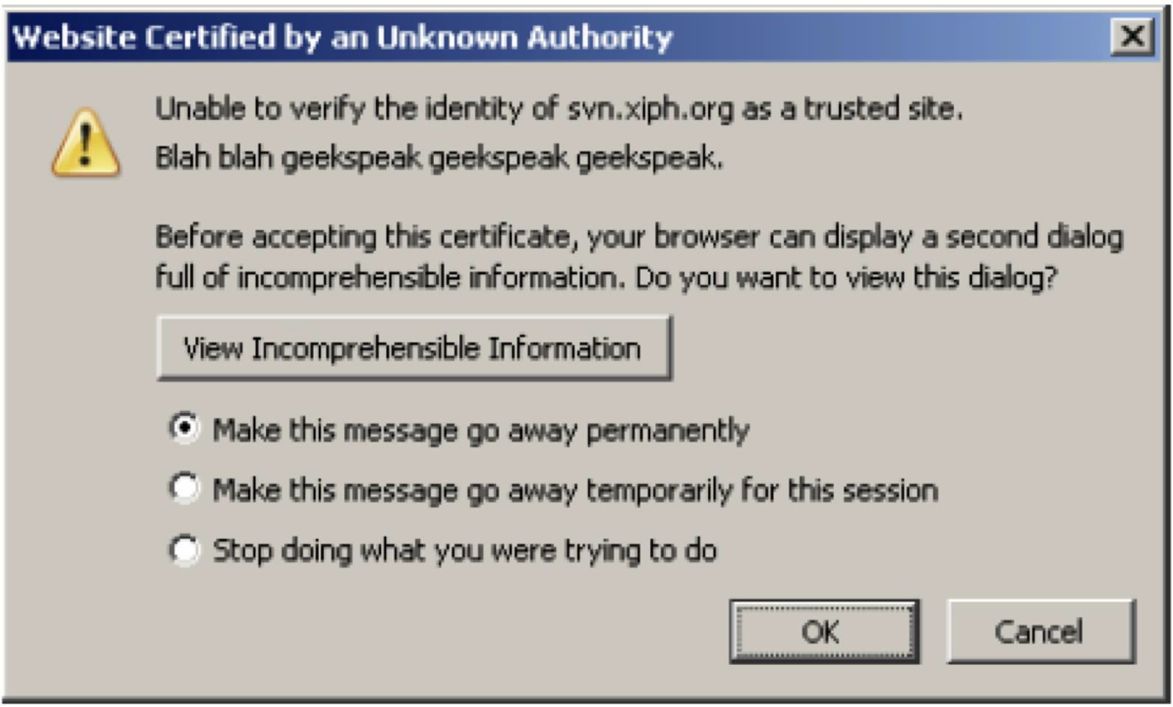
“Account for human factors”
User needs to be onboard

Slide 50
“Kerkhoff’s principle”
Don’t rely on security through obscurity
Originally defined in the context of crypto systems (encryption, decryption, digital signatures, etc.):
Crypto systems should remain secure even when an attacker knows all of the internal details
It is easier to change a compromised key than to update all code and algorithms (if you relied on security through obscurity)
Claude Shannon later redefined this as: “The enemy knows the system”

Slide 51
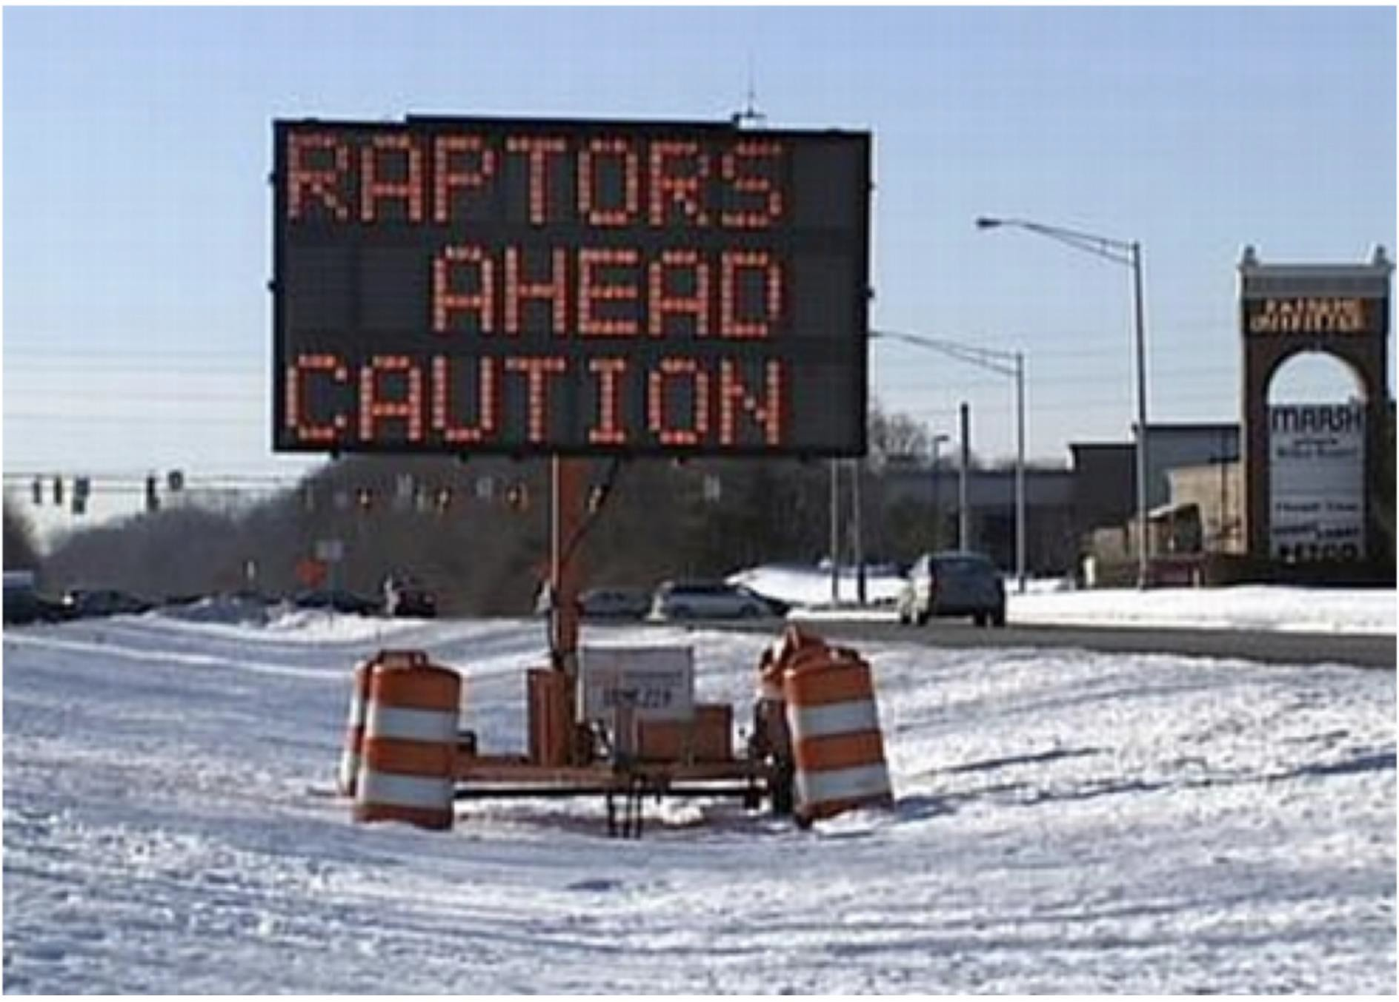
Kerkhoff’s principle??

Slide 52
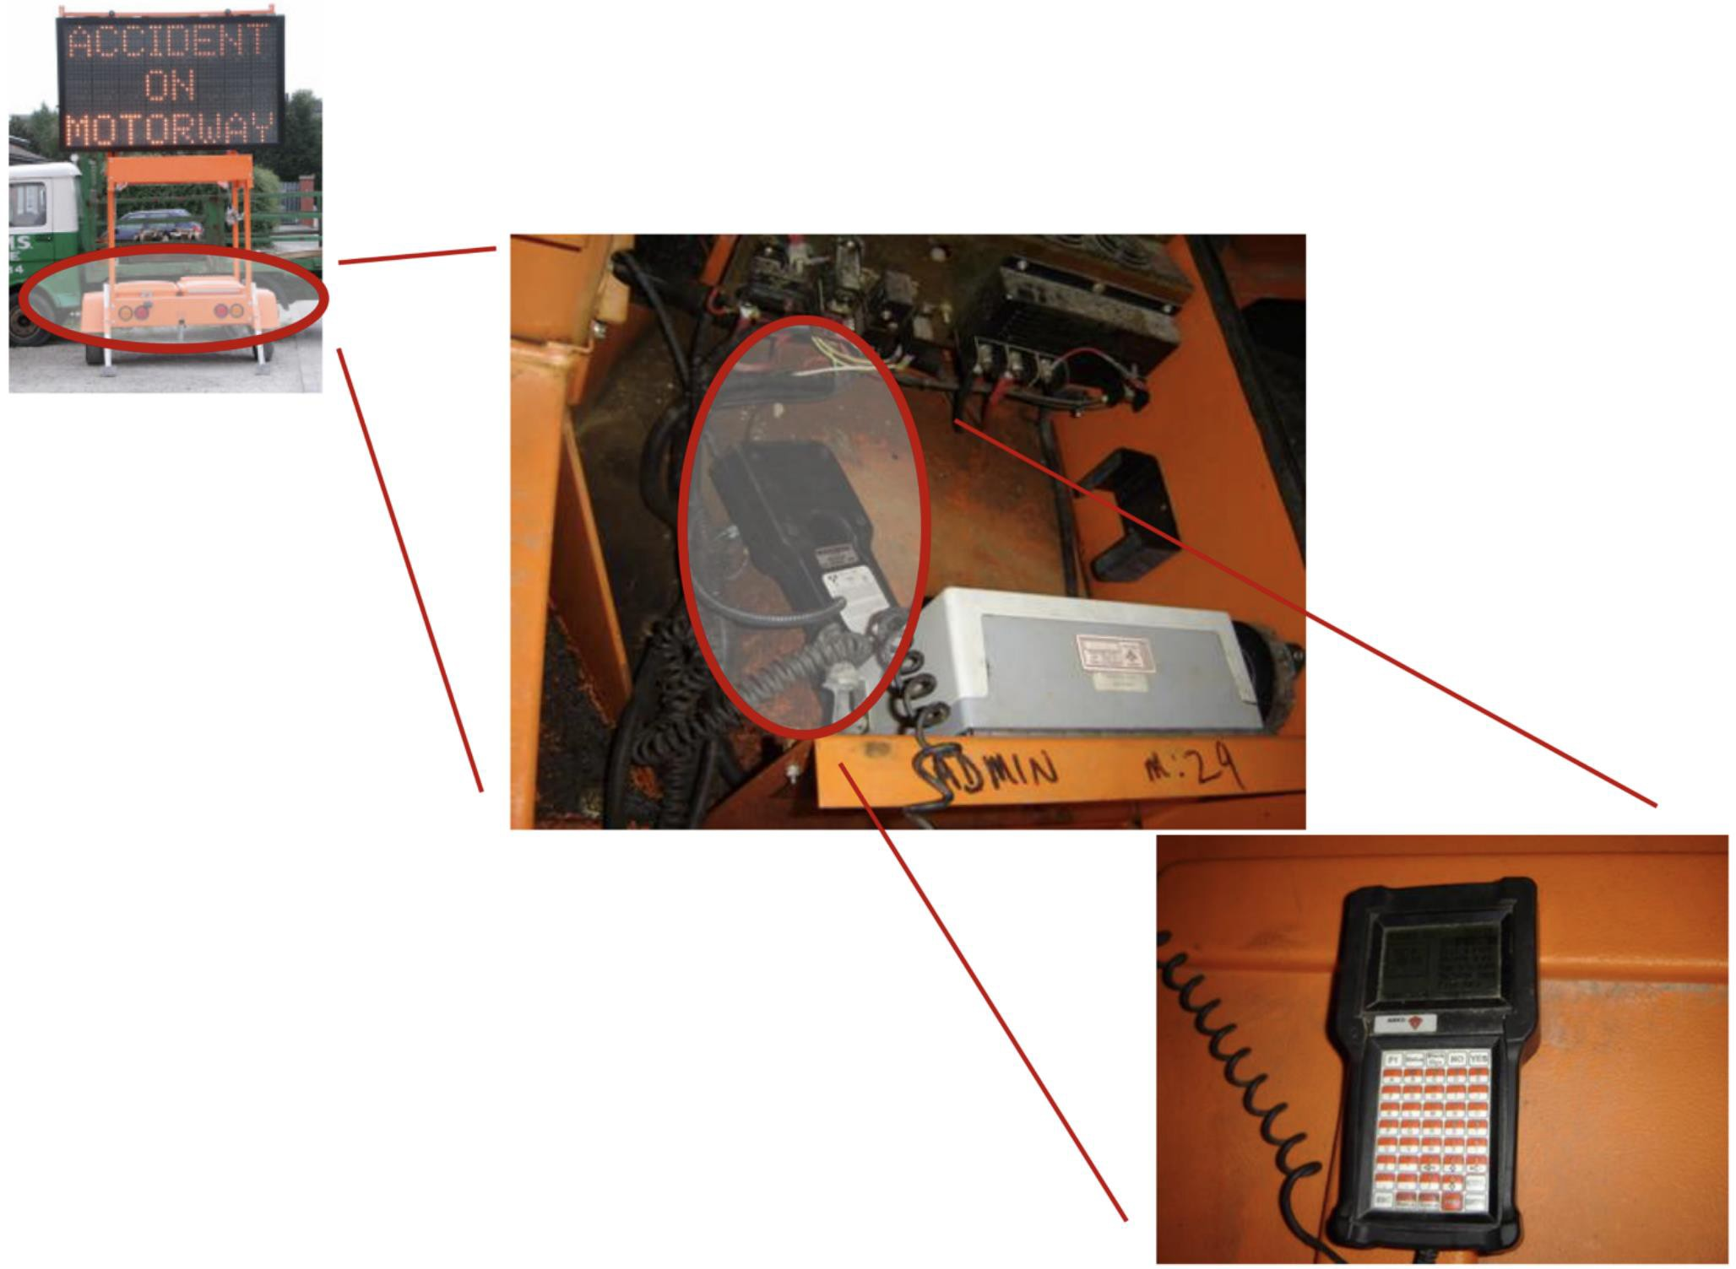
Kerkhoff’s principle!

Slide 53
Principles for building secure systems
Self-explanatory:
Accept that threat models change over time
If you can’t prevent, detect
Design security from the ground up → during the design of the entire system
Prefer conservative designs (allowing some positives to ensure you detect false negatives)
Proactively study attacks
Know these well:
Security is economics
Principle of least privilege
Use fail-safe defaults
Use separation of responsibility
Defend in depth
Account for human factors
Ensure complete mediation
Kerkhoff’s principle
Notes:
Use separation of responsibility = employ isolation

Slide 54
Trusted computing base and Code safety

Slide 55
Trusted computing bases

Slide 56
Every system has a TCB
Your reference monitor
Compiler (could allow backdoors to be injected into your code)
OS
CPU
Memory
Keyboard…..
Notes:
TCB = Trusted Computing Base.
Good security assumption when developing software security: none of the above are secure, including OS.

Slide 57
Security requires that a TCB be
Correct
Complete
Secure
Two key principles behind a good TCB:
KISS (keep it simple, stupid)
Privilege Separation

Slide 58
KISS: Small TCB
Keep the TCB small (and simple) to reduce overall susceptibility to compromise
The trusted computing base (TCB) consists of the system components that must work correctly in order to ensure security
Example: Operating system kernels
Kernels enforce security policies, but are often millions of lines of code
A compromise in a device driver compromises security overall
Better: Minimize size of kernel to reduce trusted components
Device drivers moved outside of kernel in micro-kernel designs
Notes:
Remember: firmware runs before OS, which sets up OS and memory and I/O.
So if firmware is compromised (usually through supply chain attacks), the entire system is above it is compromised.
“Dark Firmware” → see paper
Monolithic kernel= Linux → device drivers are a part of the kernel; can set it to when kernel is compiled it only includes drivers to devices connected.
One monolithic piece of code: very fast.
However, then a compromised device driver can compromise the entire kernel.
Another approach → Use microkernels: minimize size of kernel → do not include things like device driver code → move them outside of the kernel.
Windows takes a hybrid approach of monolithic (better performance) and micro (better security) kernel approaches
As programs get bigger: security reduced because there is too much complexity involved to catch all security vulnerabilities.

Slide 59
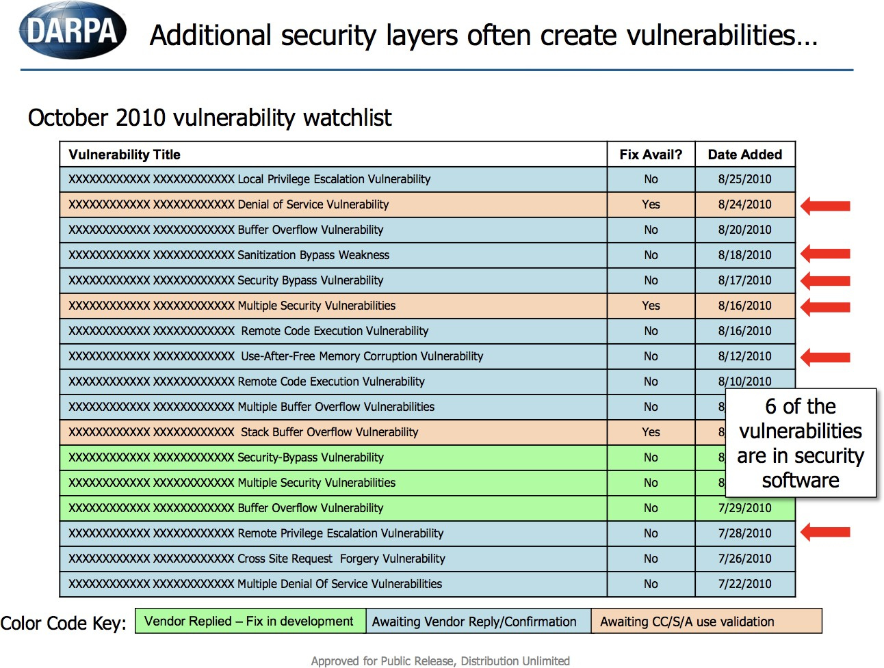
Failure: Large TCB
Security software is part of the TCB
But as it grows in size and complexity, it becomes vulnerable itself, and can be bypassed

Slide 60
TCB: Privilege Separation
Isolate privileged operations to as small a module as possible
Don’t give a part of the system more privileges than it needs to do its job (“need to know”)
Principle of least privilege
Example: Web server daemon
Binding to port 80 requires root
YOU DON’T want your whole web server running as root!
Example: Email apps often drop you into an editor
vi, emacs
But these editors often permit dropping you into a shell

Slide 61
Lesson: Trust is Transitive
Isolate privileged operations to as small a module as possible
If you trust something, you trust what it trusts
This trust can be misplaced
You have to consider the full set of dependencies of the module
you’re trusting
Previous e-mail client example
Mailer delegates to an arbitrary editor
The editor permits running arbitrary code
Hence the mailer permits running arbitrary code

Slide 62
SecComp
Linux system call enabled since 2.6.12 (2005)
An affected process can subsequently only perform read, write, exit, and sigreturn system calls
No support for open call: Can only use already-open file descriptors
Essentially, SecComp isolates a process by limiting possible interactions

Slide 63
SecComp
Follow-on work produced seccomp-bpf (derived from Berkeley Packet Filters - BPF)
Limit a process to a policy-specific set of system calls, subject to a policy handled by the kernel
Used by Chrome, OpenSSH, vsftpd, and others

Slide 64
Example: Isolate Flash Player
Receive .swf code, save it
Call fork to create a new process
In the new process, open the file
Call exec to run Flash player
Call seccomp-bpf to form a sandbox (compartmentalize)

Slide 65
Example VSFTPD
FTP: File Transfer Protocol
More popular before the rise of HTTP, but still in use
90’s and 00’s: FTP daemon compromises were frequent and costly, e.g., in Wu-FTPD, ProFTPd, …
Very thoughtful design aimed to prevent and mitigate security defects
But also to achieve good performance
Written in C
Written and maintained by Chris Evans since 2002
No security breaches disclosed so far

Slide 66
VSFTPD Threat model
Clients untrusted, until authenticated
Once authenticated, limited trust:
According to user’s file access control policy
For the files being served FTP (and not others)
Possible attack goals
Steal or corrupt resources (e.g., files)
Remote code injection (e.g malware)

Slide 67
Learn more about the VSFTPD design at:
https://security.appspot.com/vsftpd/DESIGN.txt

Slide 68
END

